Slide 1


Global Energy Insights
GROUP 10 MEMBERS
Janhavi Kharmale (U30004934)
Nidhi Falak (U79141275)
Venkata Dharma Teja (U)
Amisha Baghat (U)

Slide 2

Global Energy Insights
The objective of our website is to provide a comprehensive overview of renewable and non-renewable energy sources across various countries, along with the total energy production statistics.
Through informative content and interactive data visualization, our goal is to educate visitors about the energy landscape, highlighting the distribution of different energy sources globally.

Slide 3
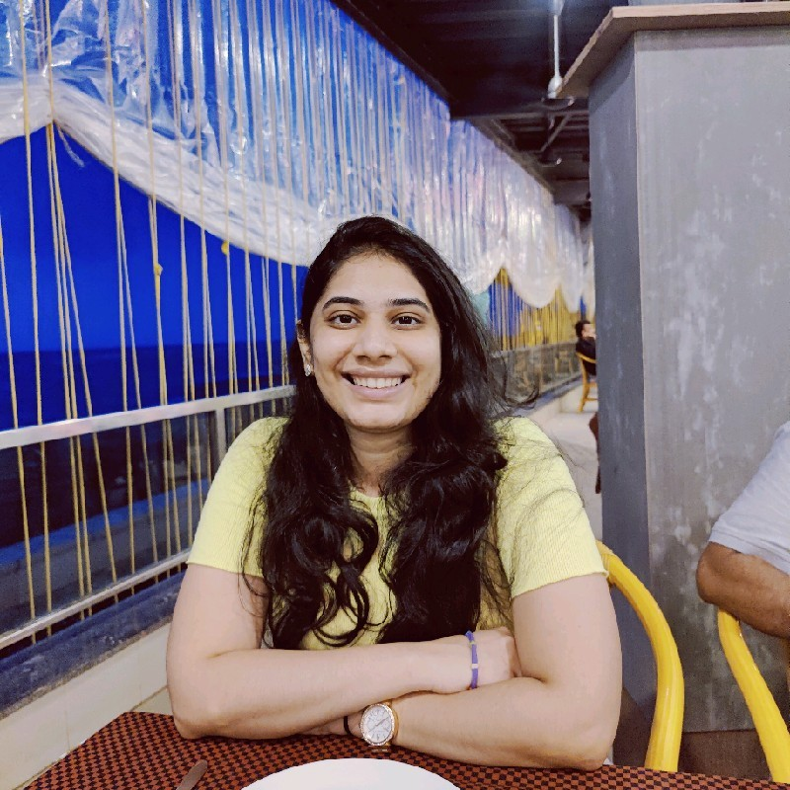
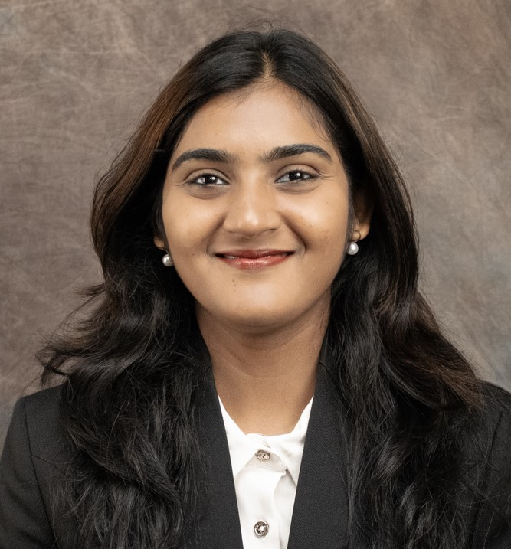
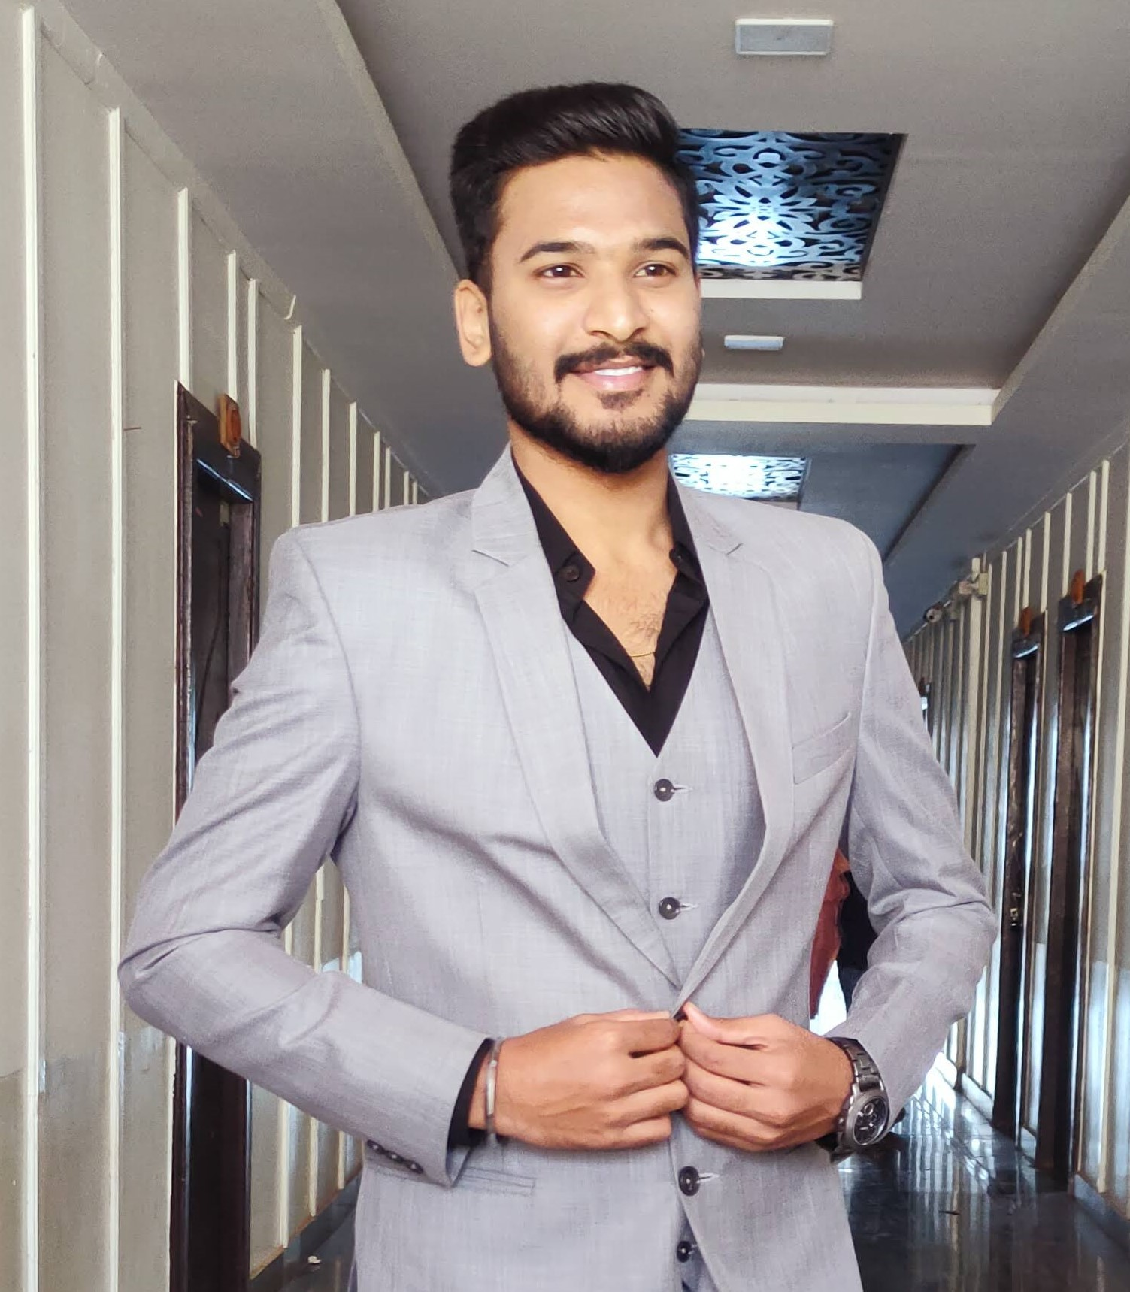
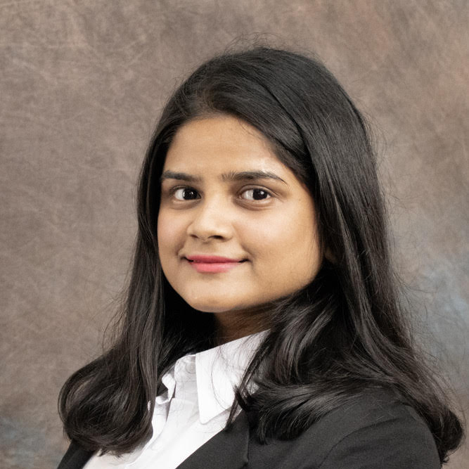
About US
Amisha Bhagat
Nidhi Falak
Venkata Dharma
Janhavi Kharmale

Slide 4

Intent and Goals of Our Website
Our website is designed with the following goals in mind to educate and empower visitors about energy resources and production:
Educational Outreach
Interactive Data Visualization
Transparency and Awareness
Subscription for Updates
Facilitate Comparative Analysis

